Slide 1
An introduction to your Career Advising Program MedCAREERS

Slide 2
Objectives
To understand the Career Advising Program structure and design within the Undergraduate Medical Education Program at the MUN Faculty of Medicine.
To identify the opportunities and resources available to medical learners to aid them in career decision making and planning.
To know how to access our help and resources through the Office of Learner Well-Being & Success

Slide 3
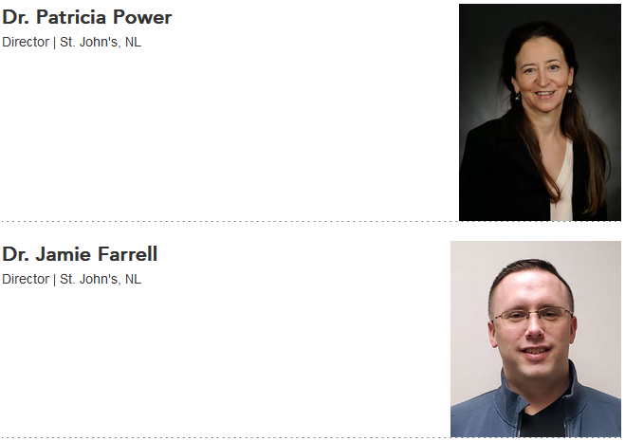
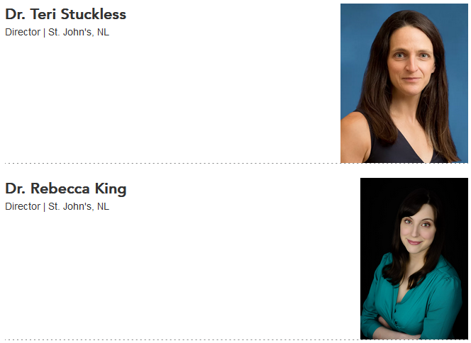
Our Team

Slide 4
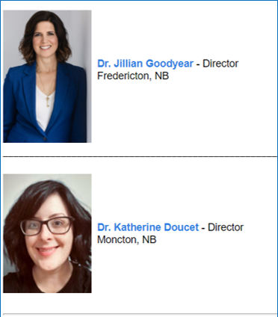
Our Team
medadvising@mun.ca

Slide 5
Why have a career advising program for undergraduate medical students?

Slide 6
Anatomical Pathology
Anesthesiology
Anesthesiology - Clinician Investigator Program
Cardiac Surgery
Dermatology
Diagnostic Radiology
Emergency Medicine
Family Medicine
Family Medicine integrated Care of the Elderly
Family Medicine integrated Emergency Medicine
General Pathology
General Surgery
Hematological Pathology
Internal Medicine
Medical Genetics and Genomics
Medical Microbiology
Neurology
Neurology - Pediatric
Neuropathology
Neurosurgery
Nuclear Medicine
Obstetrics and Gynecology
Ophthalmology
Orthopedic Surgery
Otolaryngology - Head and Neck Surgery
Pediatrics
Pediatrics - Clinician Investigator Program
Pediatrics - MD-PHD stream
Physical Medicine & Rehabilitation
Plastic Surgery
Plastic Surgery - Clinician Investigator Program
Psychiatry
Psychiatry - Research Track
Public Health and Preventive Medicine
Public Health and Preventive Medicine
including Family Medicine
Radiation Oncology
Urology
Vascular Surgery
Notes:
How many of you have thought about what you want to do after medical school?
How many of you have only thought about getting into medical school at this point?
How many of you are from NL? Other places in Atlantic Canada? The rest of Canada?
Any international students?
Anyone with children?
A spouse here? Elsewhere?
Research interests, perhaps collaborators in other places or here?
Many factors will influence your career path, within the academic curriculum and beyond.

Slide 7
Our Career Advising Program is here to help you find your path.

Slide 8
Notes:
Dr. June Harris started our program, calling it MedCAREERS, perhaps more than 20 years ago. Our programming has developed over the years, but retains the basic structure created by her.

Slide 9
Phase 1
Phase 2
Phase 3
Phase 4
Understanding
Yourself
Exploring
Options
Choosing a
Specialty
Getting into
Residency
*modelled after Careers in Medicine

Slide 10
Phase 1
Phase 2
Phase 3
Phase 4
Understanding
Yourself
Exploring
Options
Choosing a
Specialty
Getting into
Residency
MedCAREERS I
CiM
Assessments
Choosing the RIGHT Career
Personality in Practice
Physician Shadowing Orientation & OR Scrub
Military Med
Physician Shadowing
Canadian
Specialty Profiles
Specialty Nights
Talking CaRMS w/ Grads
Physician Shadowing
CaRMS Visit
MedCAREERS II
Early Prep for the MATCH
Core
Rotations
Electives
presentation
Referees
CV & PL
Interview
Skills
CaRMS Tour
YELLOW – mandatory in MedCAREERS

Slide 11
Career Options
Applying to Residency
MedCAREERS_I
Shadowing Orientation
Clerkship Preparation Course
CaRMS Document Preparation
OR Scrub Course
MedCAREERS_II
Succeeding on the Wards
Early Prep for THE MATCH
Choosing the Right Career
Year 1
Year 2
Year 3
Year 4
Phase 1
Phase 2
Phase 3
Phase 4
Pre-core Electives Discussion
(including international electives)
Elective/Selective Advice
(& introduction to online portal)
Choosing Electives

Slide 12
Curriculum
Much of content suggested by students
Students organize many events
Students / Residents / Faculty give presentations
and participate in activities
Collaborate with UGME
Career Advisory Group gives direction

Slide 13
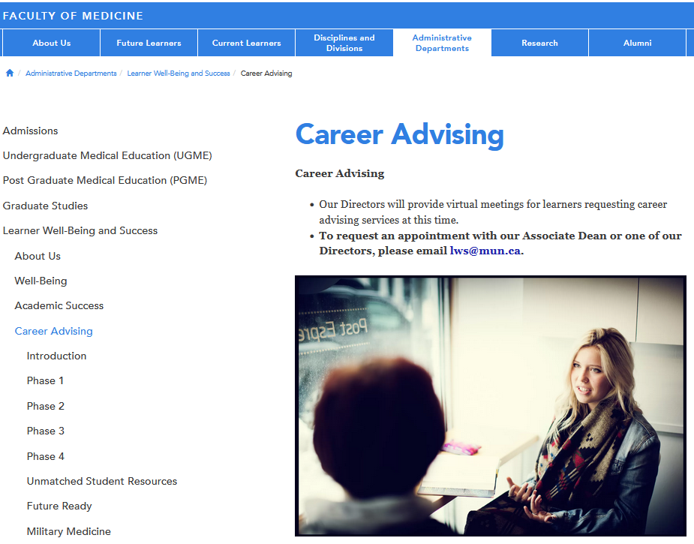
https://www.mun.ca/medicine/administrative-departments/learner-well-being-and-success/career-advising/

Slide 14
WEBSITE TOUR

Slide 15
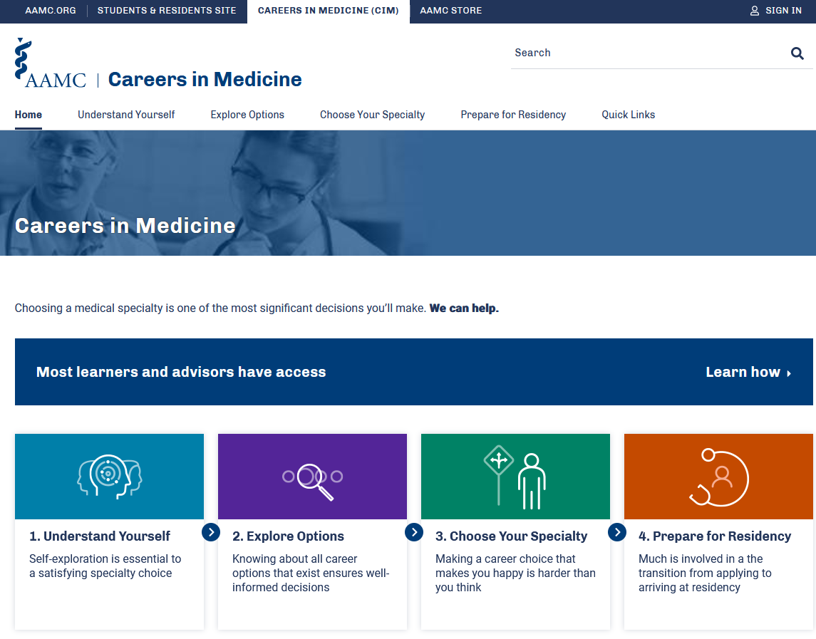
AAMC Careers in Medicine (CiM)
Anders will email out your username and password later today,
if you have any issues please email medadvising@mun.ca

Slide 16
Wow, everything is interesting, how can I possibly decide?
My partner’s job is not transferrable. I need to end up in the same city if we are going to make it work
I think I want to do something surgical…I love hands-on work.
Family medicine for me – I love the continuity of care and preventative medicine. I can really make a meaningful difference in people’s lives.
Do I want to be in a large academic center or somewhere smaller?
I have wanted to be a geneticist since my cousin was found to carry the BRCA gene.
My arthritis is affecting my hands more. I need to consider this when making my career choice.

Slide 17
Notes:
In Phase 4, your goal should be to have made a decision about which programs you want to apply for in residency. Remember, the task is not to find your “one true calling”. For most of you, there will be a variety of options that appeal to you. Ultimately, you have to make a decision. With our programming, we aim to provide you the tools and resources to make an informed decision that leads to a successful career.

Slide 18
Take advantage of all opportunities so you can make an informed decision.
Notes:
Ultimately, you have to make a decision. With our programming, we aim to provide you the tools and resources to make an informed decision that leads to a successful career.

Slide 19
Book an appointment!
You will each be assigned a Career Advisor in the coming week:
LWS Directors
Dr. Jamie Farrell
Dr. Patti Power
Dr. Teri Stuckless
Dr. Rebecca King

